Slide 1
MeDAL and Amazon Data Classification Using PySpark
Team 13
Kanisettypalli Harshitha
Kavya Duvvuri
Kunisetty Jaswanth

Slide 2
PySpark Terminologies
Parallel Processing
Resilient Distributed Dataset (RDD)
Partitions
Cache and Persist
Executors
Spark Jobs and Stages
Directed Acyclic Graphs (DAG)

Slide 3
MeDAL Dataset Description
Abbreviation sense disambiguation is the logic that determines which of an abbreviation sense is the most relevant for a given instance of an abbreviation.
In this project medical abstracts have been taken up and the full form for a given medical abbreviation has been found.
There can be multiple options available but selecting the best word is the key challenge of the problem.
This dataset is 5 GB large, and it requires high computational strength of systems to be able to fit the large amount of data.

Slide 4
Amazon Dataset Description
Amazon is a multinational company that provides an online platform for shopping for a wide range of products.
Millions of Amazon products are bought every year and they receive mixed reviews.
It is extremely necessary to identify the sentiment behind these reviews and modify the products accordingly.
This helps the company in gaining more customers. Also, knowing the general rating of the previous reviews helps customers in making better choices when selecting their products.

Slide 5
Important Definitions
Tasks: Smallest execution unit in the pyspark. Tasks are executed inside the executor.
Stages: A stage comprises of several tasks and every task in the stage executed the same set of instructions
Jobs: A Job comprises of several stages.
Whenever Spark encounters a function that requires a shuffle it creates a new stage. Transformation functions like reduceByKey(), will trigger a shuffle and will result in a new stage. Spark will also create a stage when you are reading a dataset.
Application: It comprises of several jobs. A Job is created whenever we execute an action function.

Slide 6
Executors in PySpark
Executors are the worker nodes in charge of running individual tasks in the spark job.
They are launched at the beginning of the spark application and typically run for the entire life time of the application.
Once they execute the task they send the results to the driver.
By default pyspark allocates 2 executors per node
We can set the number of executors using the command “--num-executors NUM”

Slide 7
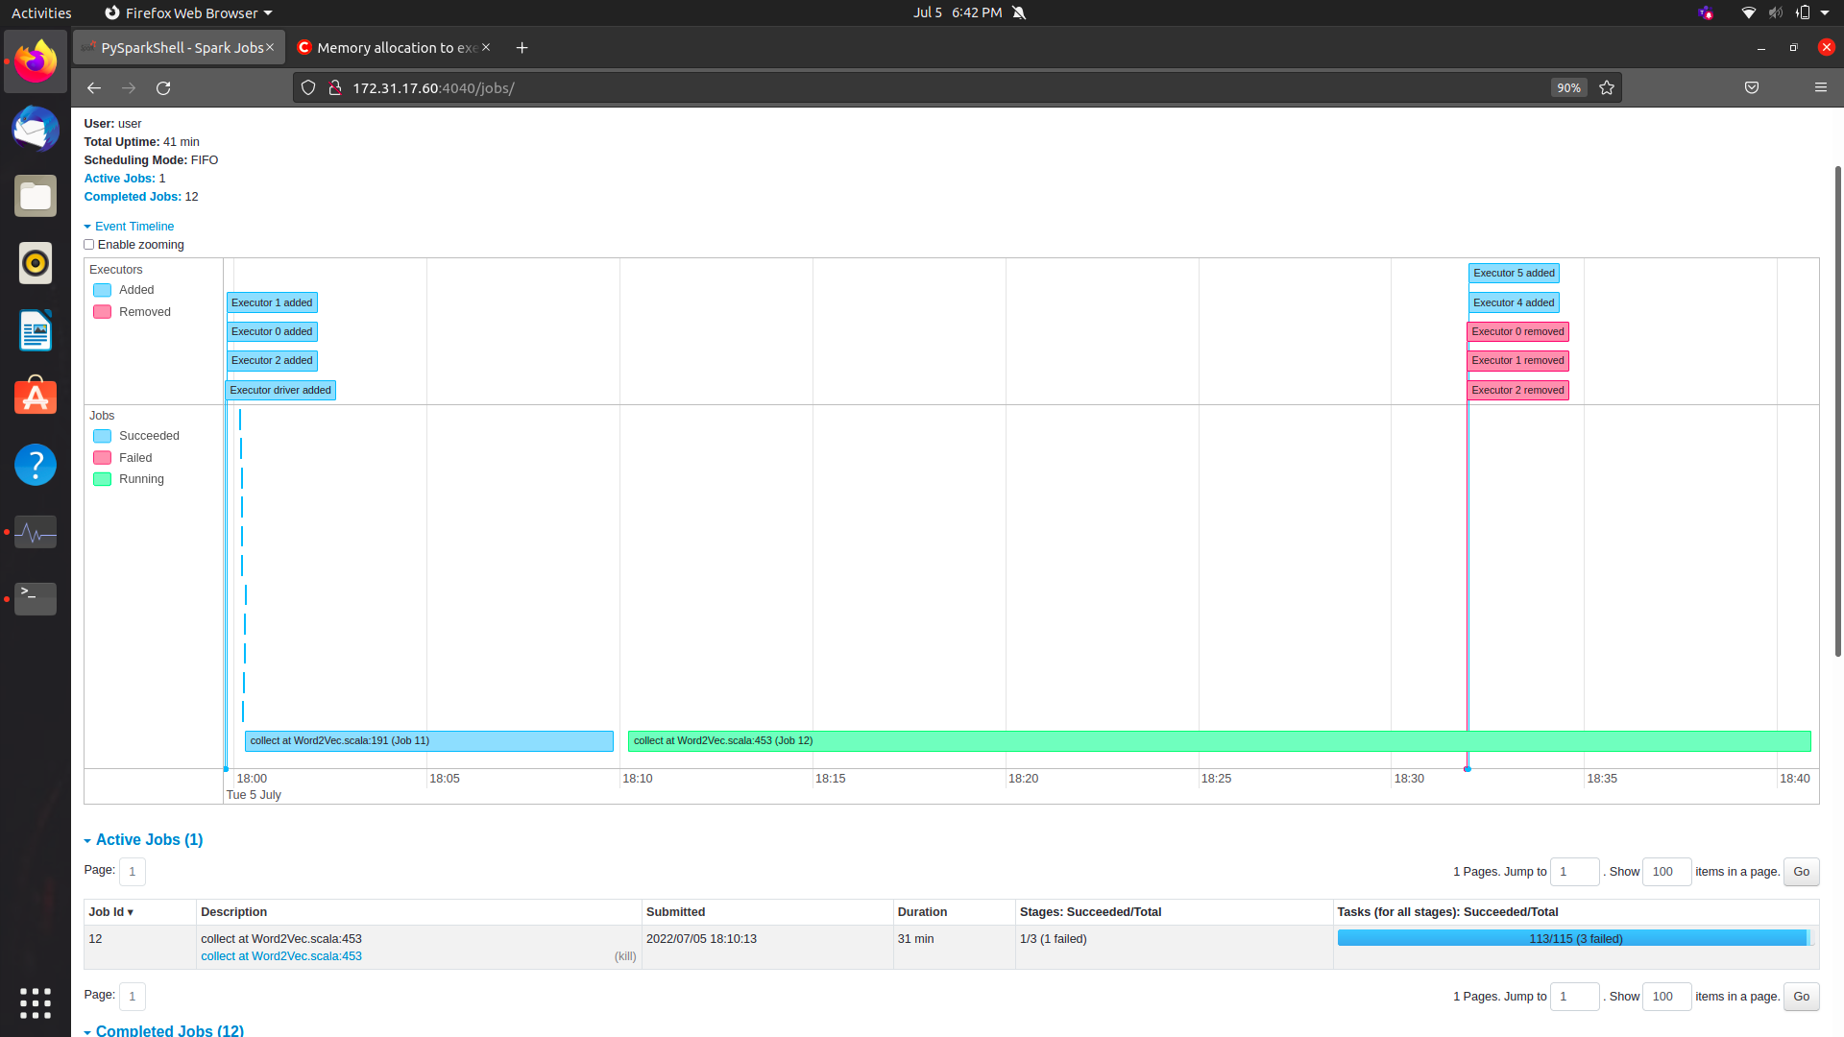
Executors in PySpark

Slide 8
Directed Acyclic Graph (DAG)
The execution of spark processes can be visualized as a graph with the vertices representing RDD’s and the edges representing the operation to be applied.
DAG scheduler is a scheduling layer in a spark which implements stage oriented scheduling. It converts logical execution plan to a physical execution plan. When an action is called, spark directly strikes to DAG scheduler. It executes the tasks those are submitted to the scheduler

Slide 9
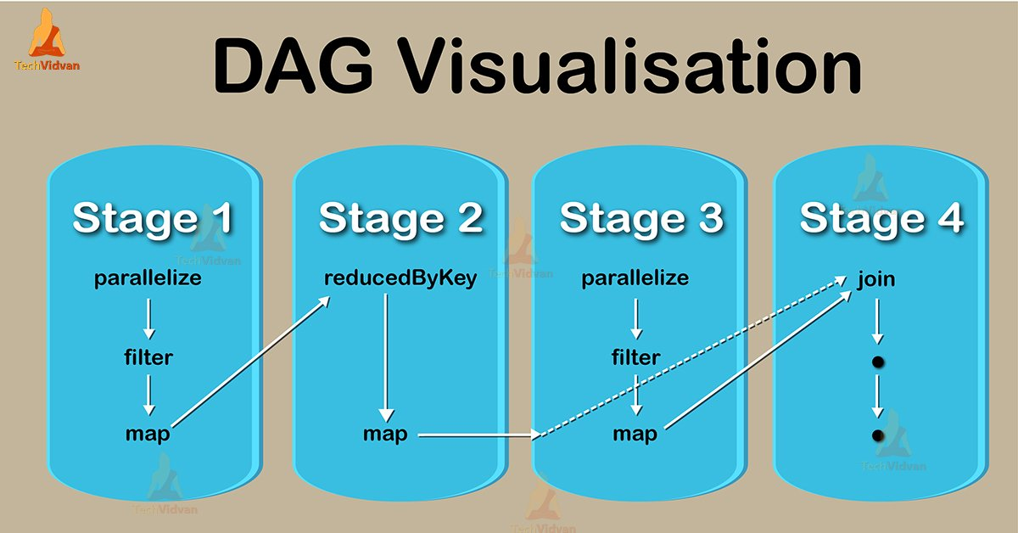
DAG Visualizer

Slide 10
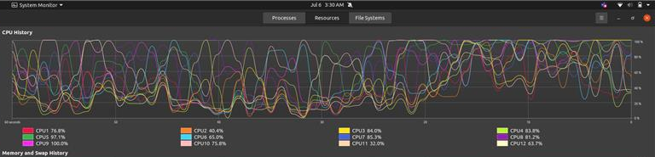
Task Parallelism in PySpark

Slide 11
System Workflow
Drop the unnecessary columns
Filter the rows with specified conditions
Use the tokenizer to separate the words of the text into an array of strings
Use the Word2Vec model to transform the text into vectors of specified size
Use the StringIndexer to obtain indices for labels in the dataframe
Drop duplicated rows in the dataframe
Fit the selected model to the dataframe and make predictions

Slide 12
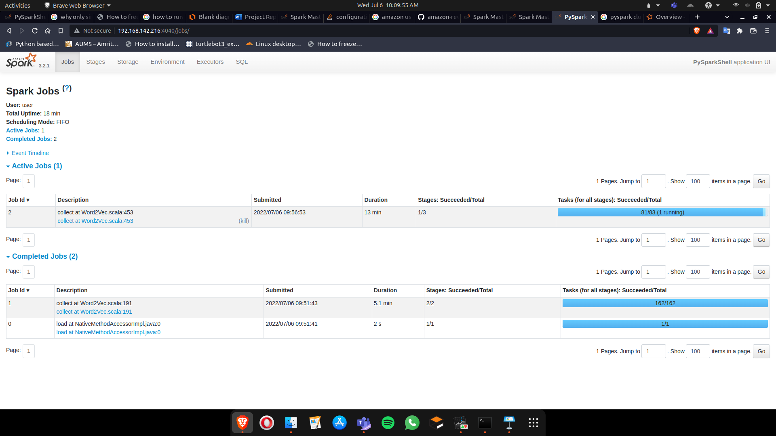
Execution

Slide 13
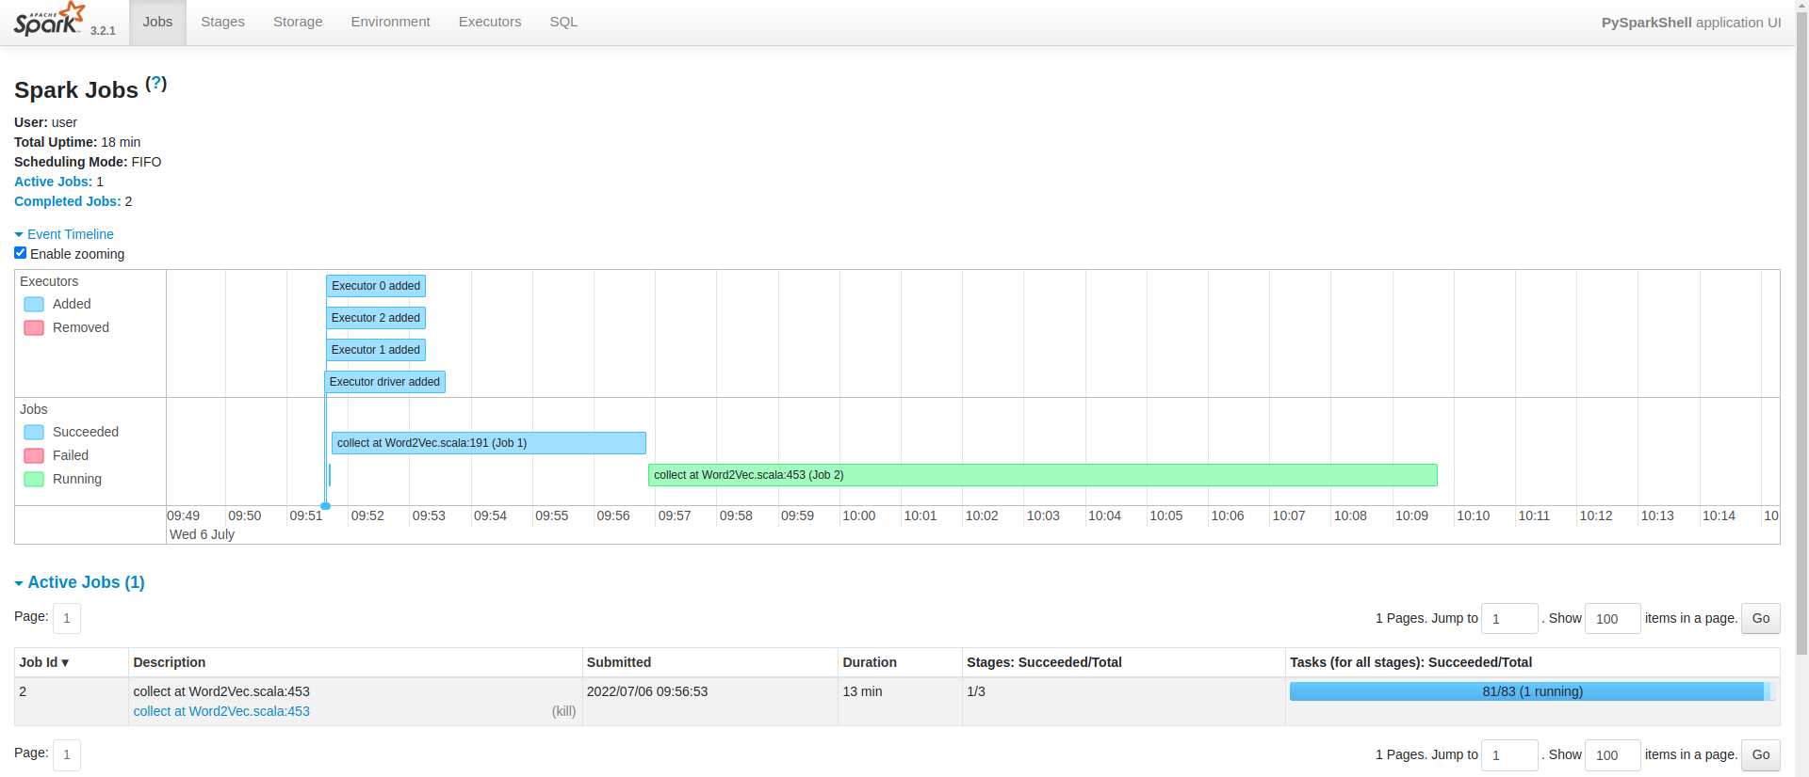
Execution

Slide 14
Commands Used
Command to initialize the master node : ./start-master.sh
Command to initialize the slave nodes: ./start-slave.sh spark://(master_ip):7077
Command to initialize the pyspark terminal as a master: ./pyspark --master spark://(master_ip):7077
./pyspark --master spark://(master_ip):7077 --driver-memory 32G --executor-memory 32G --driver-cores 20 --conf spark.driver.maxResultSize=32g
To make the master node also work : ./start-slave.sh spark://(master_ip):7077 in the sbin of spark directory

Slide 15
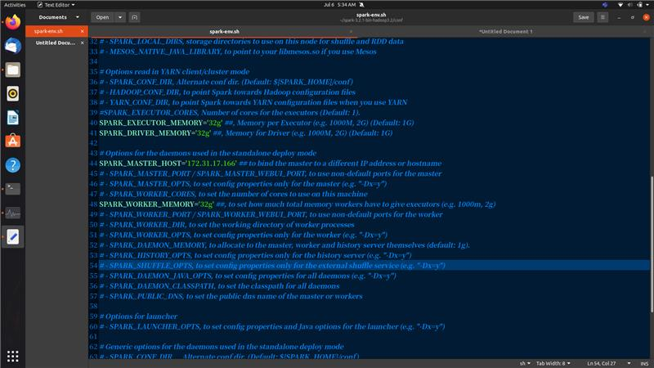

Slide 16
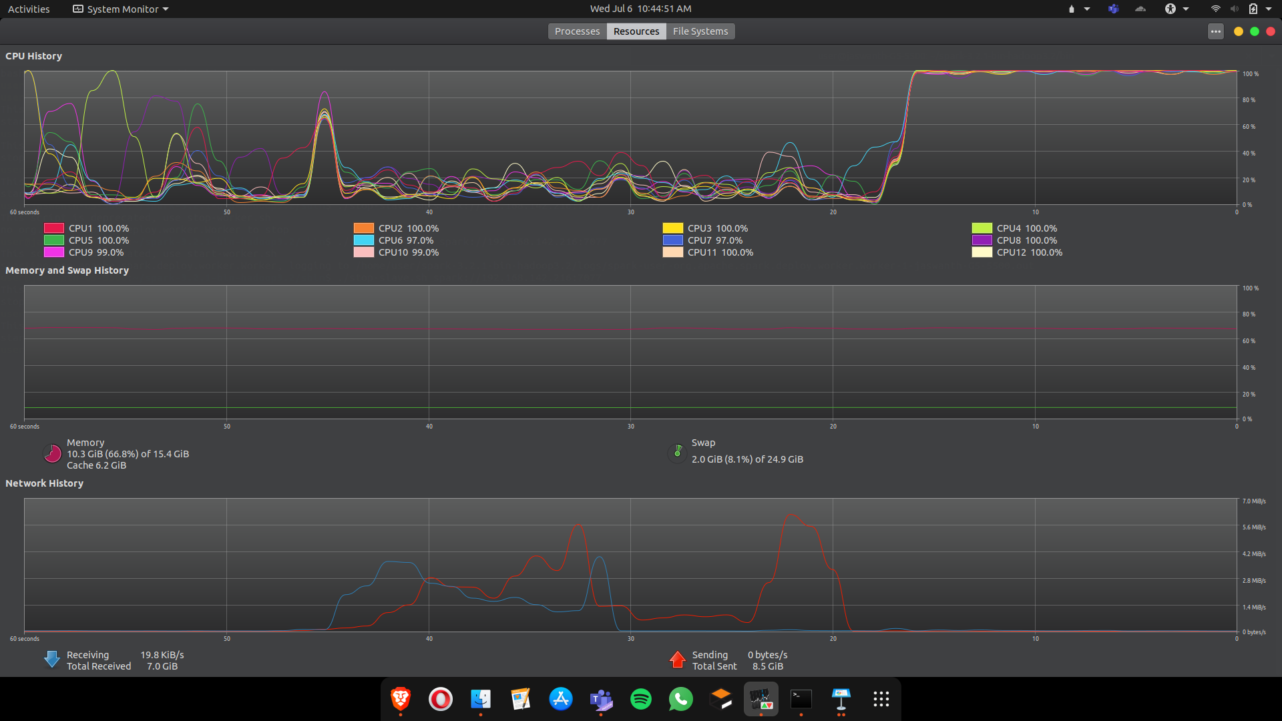

Slide 17
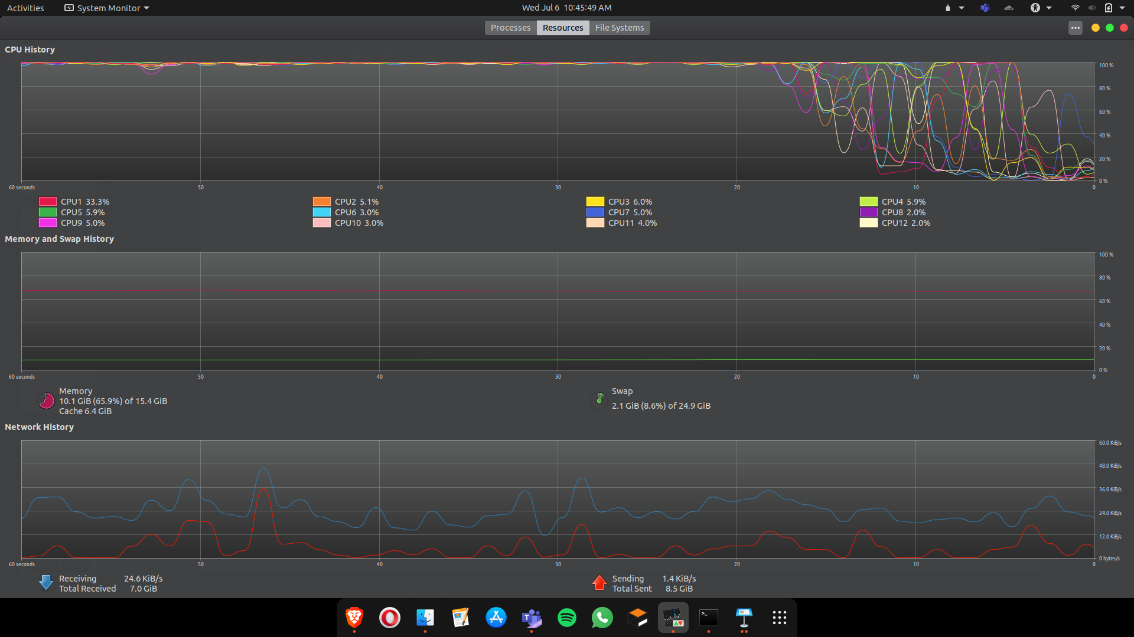

Slide 18
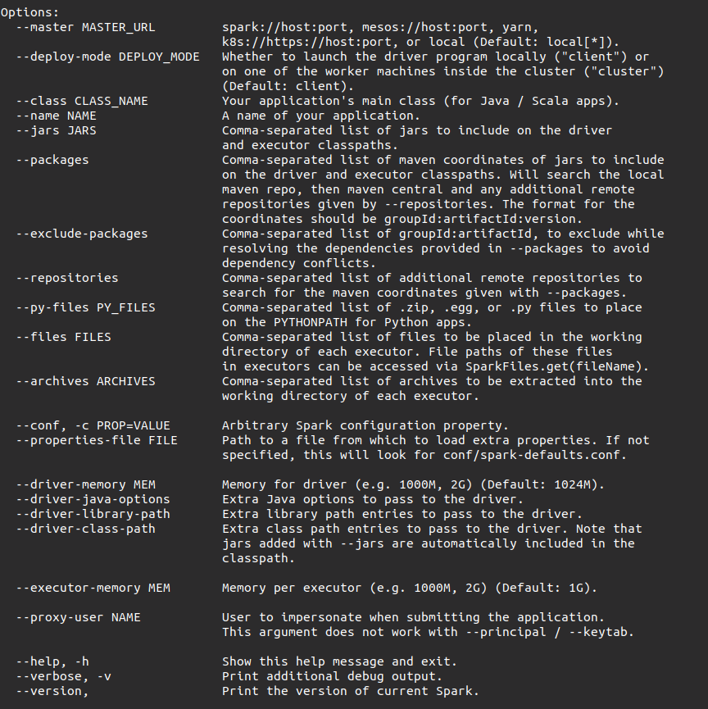
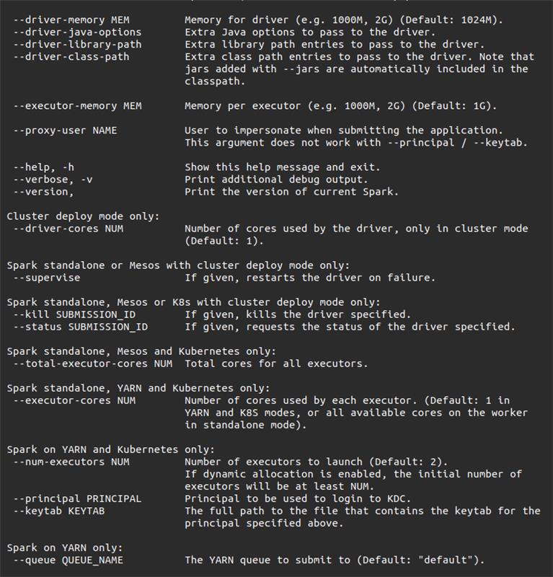
PySpark Optimization Features

Slide 19
References
https://spark.apache.org/docs/2.1.0/ml-classification-regression.html
https://stackoverflow.com/questions/40981512/spark-cores-tasks-concurrency/41171632#41171632
https://stackoverflow.com/questions/34597923/how-to-set-the-number-of-partitions-nodes-when-importing-data-into-spark
https://spark.apache.org/docs/latest/

Slide 20
Thank YOU

